Slide 1
TITLE PAGE
Problem Statement Title : Smart Endoscopic Pipe Monitoring Robotic Arm
Theme - Miscellaneous
PS Category- Hardware
Name - Akshay V

Slide 2
IDEA TITLE: Smart Endoscopic Pipe Monitoring Robotic Arm
ZenX
Proposed Solution
Flexible rod with ESP32-CAM and servo motors inspects pipes.
Live video analyzed via Python + OpenCV for cracks or blockages.
Auto-detects and fixes cracks (sealant) & blockages (chemical spray) — no dismantling needed.
Servo-based steering, Real-time visual detection, Automated in-pipe repair, Cost-effective & IoT-enabled

Slide 3
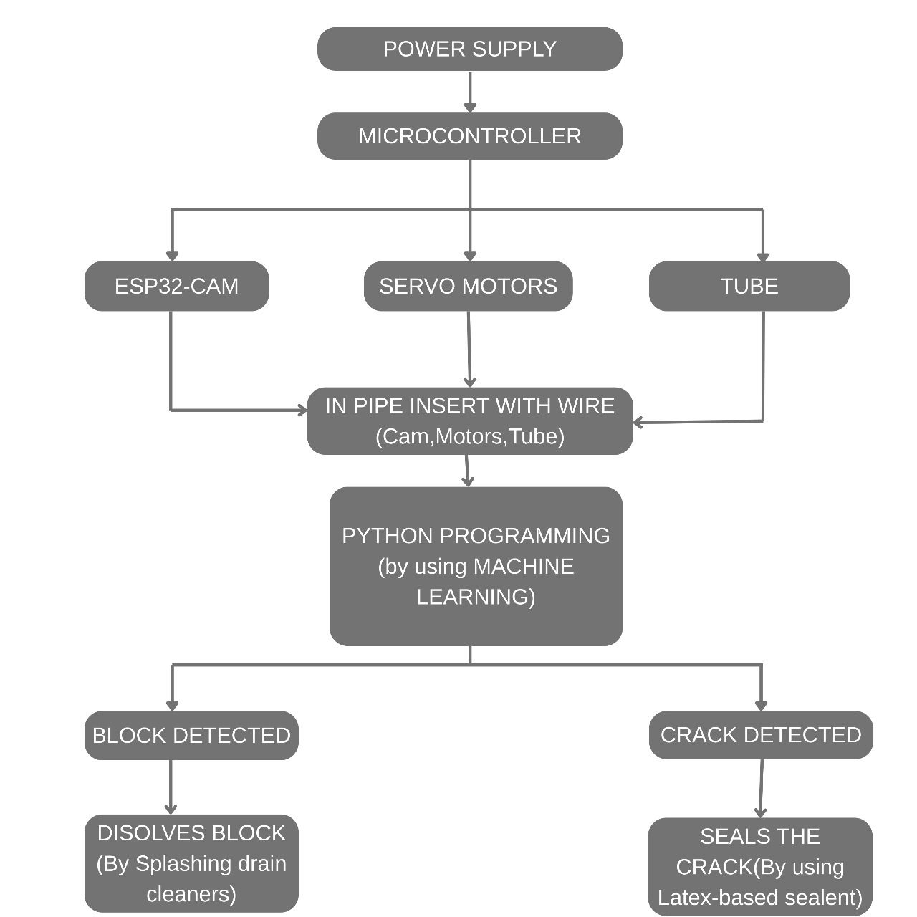
TECHNICAL APPROACH
ZenX
Hardware: ESP32-CAM, Servo Motors, MB Board. Software: Python, OpenCV. Protocols: Wi-Fi (video transmission).
Device enters pipe → Streams video → Detects issue → Applies fix automatically
A flexible device with ESP32-CAM streams video via Wi-Fi, detects cracks or blocks using OpenCV, and fixes them using sealant or chemical spray.

Slide 4
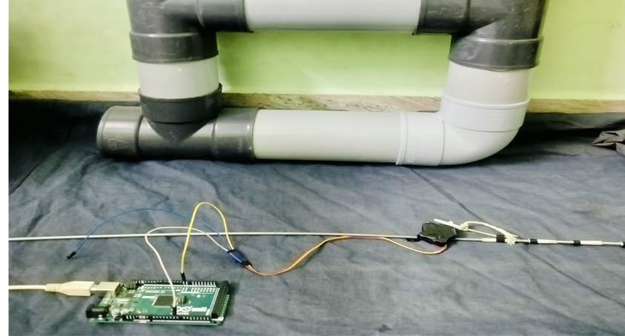
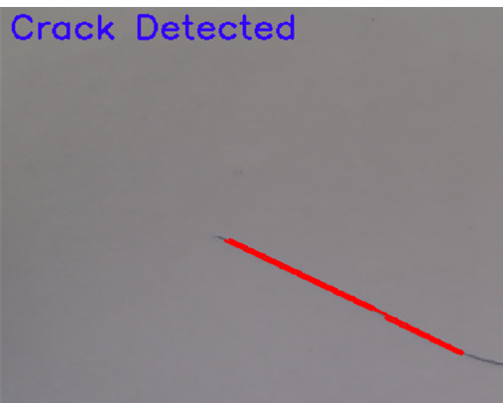
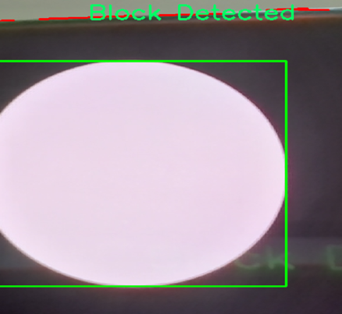
FEASIBILITY AND VIABILITY
ZenX
Technically viable using low-cost IoT hardware and Python-based CV. Suitable for home pipe systems.
Camera clarity in dark/narrow pipes. Accurate crack/blockage detection Servo control in tight bends.
Use LED with ESP32-CAM. Train detection with sample data. Calibrate servo angles with testing

Slide 5
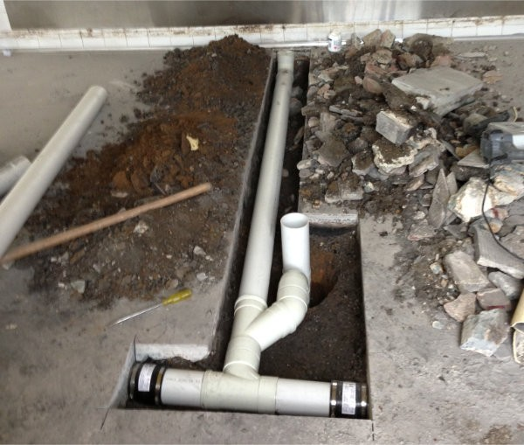
IMPACT AND BENEFITS
ZenX
Helps homeowners detect and fix pipe issues quickly, cheaply, and non-invasively.
Benefits:
💸 Economic: Reduces repair costs and water loss
🌱 Environmental: Prevents water leakage and damage
🏠 Social: Minimizes disruption, no pipe dismantling
🔧 Technical: Encourages smart home automation adoption

Slide 6
RESEARCH AND REFERENCES
ZenX
Vision-Based Pipe Monitoring Robot For Crack Detection Using Canny Edge Detection Method As An Image Processing Technique.
Link:https://www.researchgate.net/publication/320115527_Vision-Based_Pipe_Monitoring_Robot_For_Crack_Detection_Using_Canny_Edge_Detection_Method_As_An_Image_Processing_Technique
Design and Fabrication of In-Pipe Inspection Robot for Crack Analysis and Detection Using OpenCv and Visual Odometry.
Link:https://d1wqtxts1xzle7.cloudfront.net/105199173/IRJET_V10I750-libre.pdf?1692708401=&response-content-disposition=inline%3B+filename%3DDesign_and_Fabrication_of_In_Pipe_Inspec.pdf&Expires=1758124423&Signature=hRVq55icLRbHl5rw9nlsYGlxps1Z8UMsvcYcNJ589Tke8QVmmYfrO6kjYgydD-hfKhy~xt8bHV0g9O1UMIFnGClhPGcLaFDozVDeQJEDEWF2nn~9eWPNsw2Dh4W19VKvFCHDGiRT9Isv8p-jao8gspMCPRMXYPYEquCcKtKDaE5VJuyazdWD5N9a~j6E0UxJADzfQvbbiJXM4R0gBwwv0042cVNkcoLRj55nrW6Kul53H8GF2WaIgbWDDZvFu2q2~VP9jnPL6vrsrYRsUzUc1yW84kwj9Th2NH7nxy22q8PAYdD-4BcVorLPOKtguWAgvLGcilfqZjfBmFQc7MVJZw__&Key-Pair-Id=APKAJLOHF5GGSLRBV4ZA

